Slide 1
How js works behind the scene ?
How browsers understand the code (Js engines).
Stack Vs Heap
Compilation Vs Interpretation Vs JIT Compilation
The whole process to convert code to 0’s and 1’s
Parser ?
AST ?
Js Runtime
Engine + Web APIs + CallbackQueue
Execution context and callstack
Scope and Scope chain

Slide 2
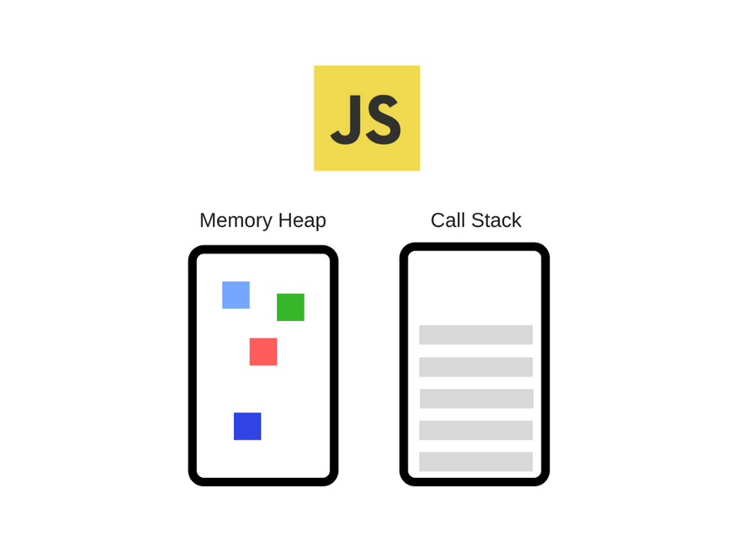
Js Engine : heap + stack - what’s inside heap and stack ?

Slide 3
Compilation Vs interpretation Vs JIT
Read this :JIT Compilation

Slide 4
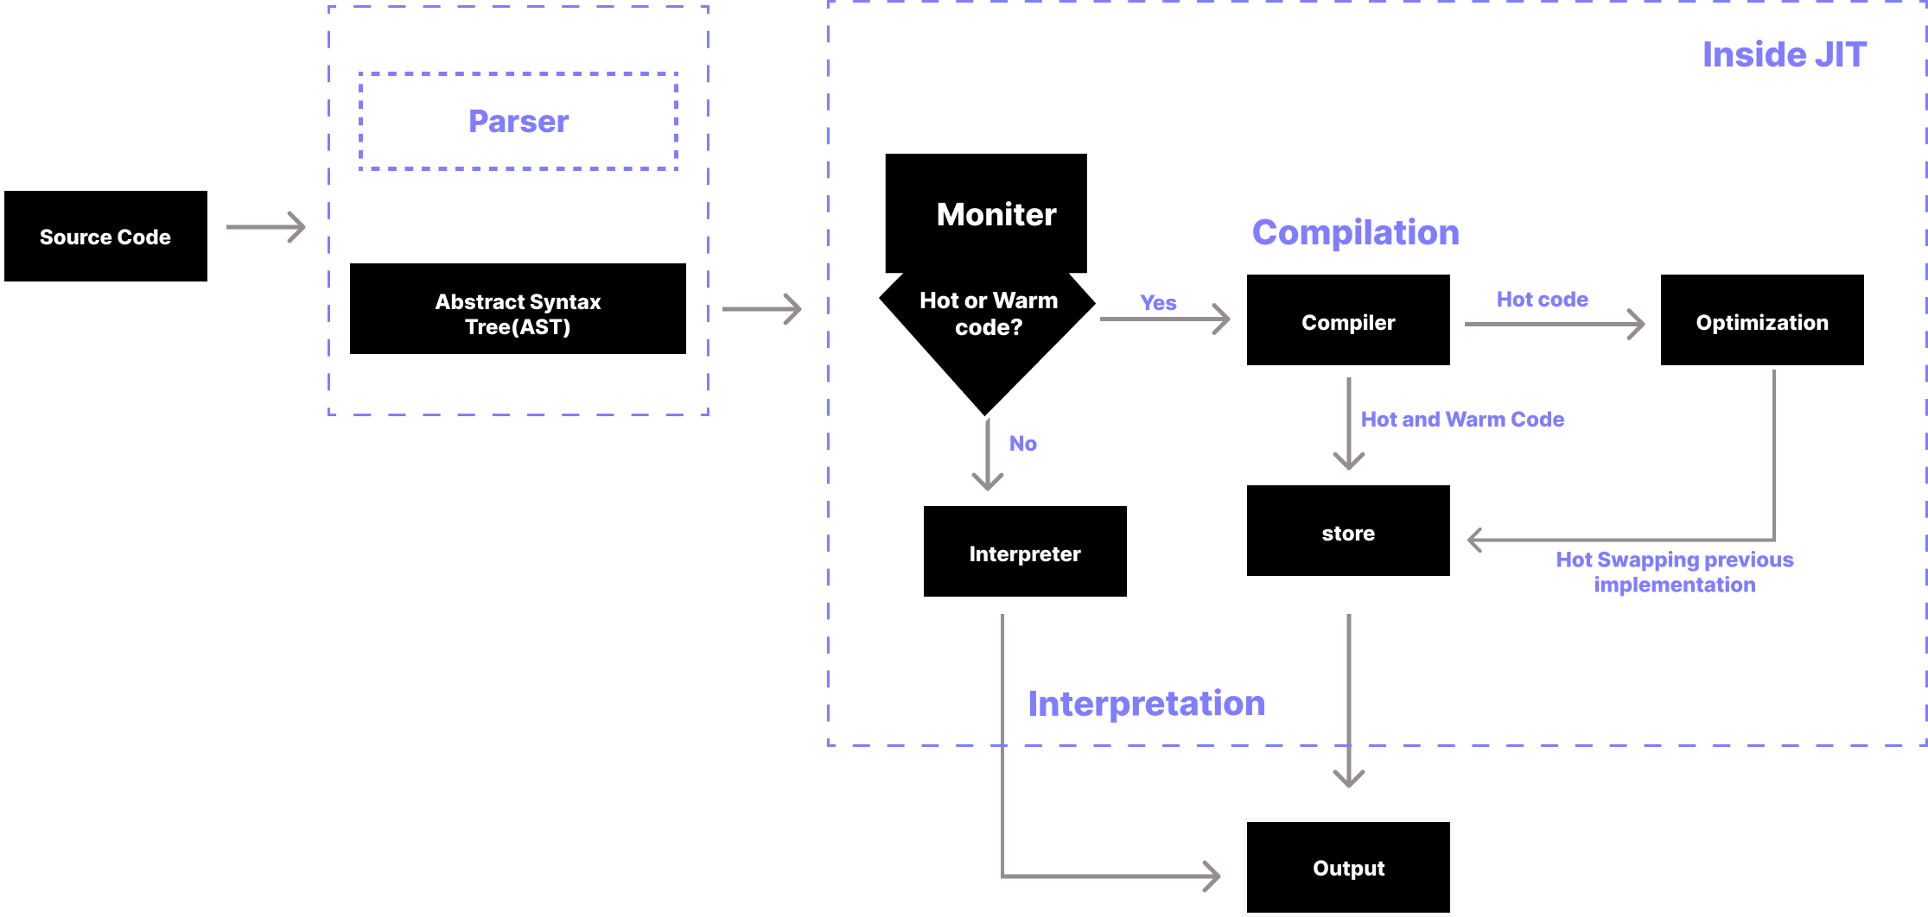
Code → 0’s and 1’s
Notes:
AST ? : https://astexplorer.net/

Slide 5
Execution context and Callstack:
Everything in js happens in execution context
EC contains the following :
Variable environment
Scope chain
“This” key word
Execution context ? Box ? Environment ? Piece of code inside the stack ?
Global execution context , only one ?!
One execution context per function ? : For each function call, a new execution context is created
Variable environment ? Each EC has it’s variable environment ! Is it the heap ?

Slide 6
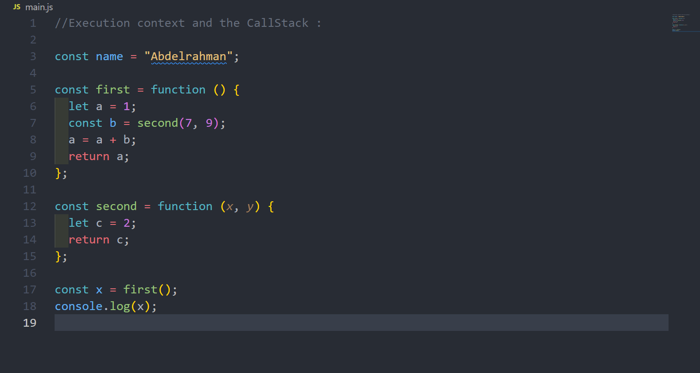
Example of EC and the CallStack

Slide 7
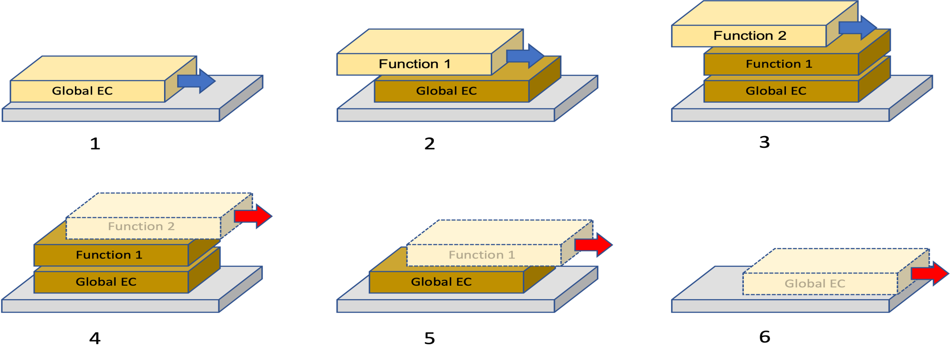
.
1. We start with an empty stack, and the first thing that happens is we add an execution context (EC) for the global context.
2. Global code calls Function 1, and so we add an EC for that to the stack.
3. Function 1 calls Function 2, and so we add an EC for that to the stack.
4. Now function 2 is done with its job, and so we pop its EC off the stack, returning control to Function 1.
5. Now function 1 is done with its job, and so we pop its EC off the stack, returning control to the global code.
6. Finally the global code is done too, and we pop that off the stack.

Slide 8
Summery for EC ☺
It makes sense now that we say that Java script code runs inside the call stack.
And actually it is more accurate to say that code runs inside of execution contexts that are in the stack.
But the general point is that code runs in the call stack,

Slide 9
Scope Chain
Scoping: How our program’s variables are organized and accessed. “Where do variables live?” or “Where can we access a certain variable, and where not?”
Scope: Space or environment in which a certain variable is declared (variable environment in case of functions). There is global scope, function scope, and block scope
Scope of a variable: Region of our code where a certain variable can be accessed

Slide 10
Types of Scopes
Three types :
Global Scope
Function Scope
Block Scope

Slide 11
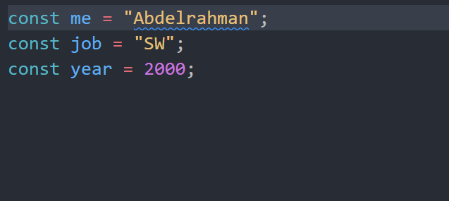
Global Scope

Slide 12
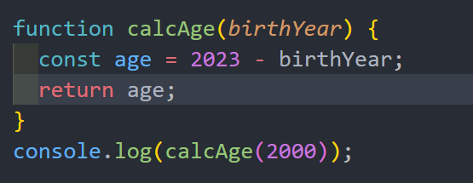
Function Scope

Slide 13
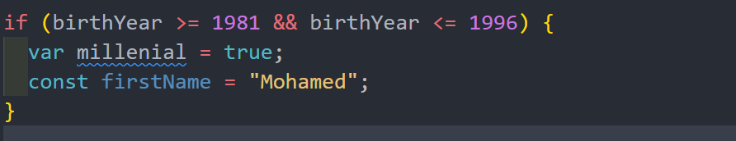
Block Scope

Slide 14
SUMMARY ☺
Scoping asks the question “Where do variables live?” or “Where can we access a certain variable, and where not?”
There are 3 types of scope in JavaScript: the global scope, scopes defined by functions, and scopes defined by blocks
Only let and const variables are block-scoped. Variables declared with var end up in the closest function scope
Every scope always has access to all the variables from all its outer scopes. This is the scope chain
When a variable is not in the current scope, the engine looks up in the scope chain until it finds the variable it’s looking for. This is called variable lookup
The scope chain is a one-way street: a scope will never, ever have access to the variables of an inner scope

Slide 15
Hoisting ?

Slide 16
Resources and Tasks
Watch these videos
How JavaScript Code is executed?
Execution Context
Scope Chain
Hoisting You will demonstrate this topic to me ☺
Read those articles
JavaScript Engine
Scope Chain
Hoisting

